Slide 1
Statistical Parsing

Slide 2
PCFG
Probabilistic Context Free Grammar is combination of four symbols (N,∑,R,S)
N- Non-terminal
∑- Terminals
R – Rules (A->B (P)) NP->N (0.15)
S – Start symbol

Slide 3
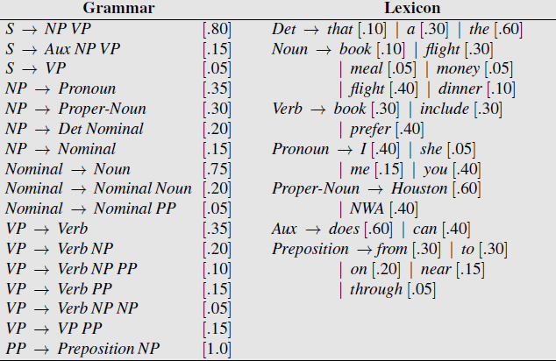

Slide 4
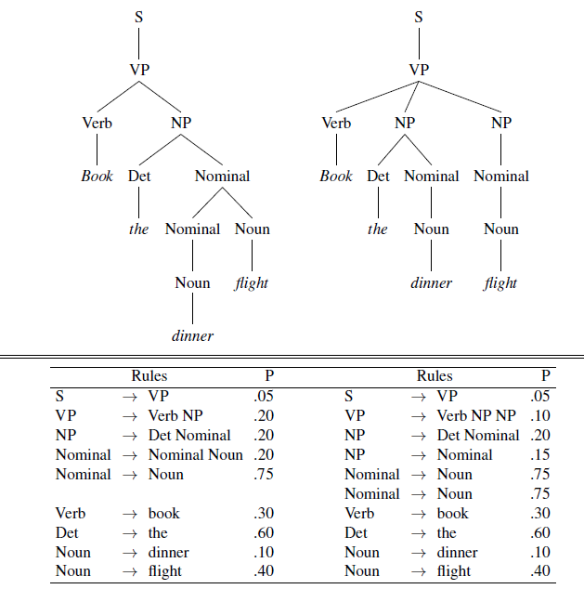

Slide 5
P(I)= 0.5*0.20*0.20*0.60*0.20*0.75*0.10*0.40*0.30= 2.2*10^-6
P(II)= 0.05*0.10*0.20*0.15*0.75*0.75*0.30*0.60*0.10*0.40 =6.1*10^-7

Slide 6


Slide 7
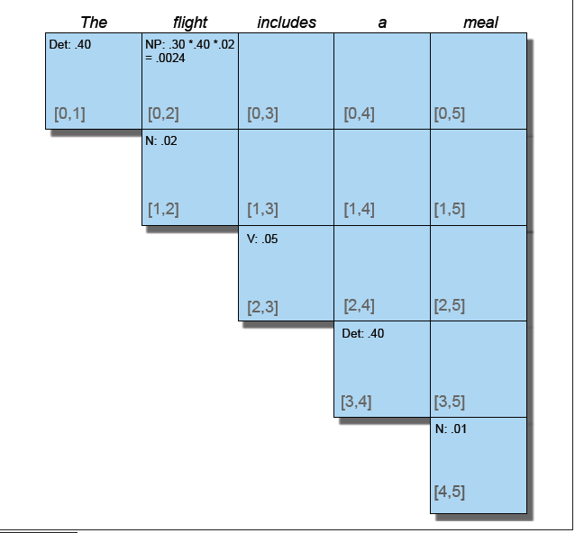
PCYK Parser

